Slide 1
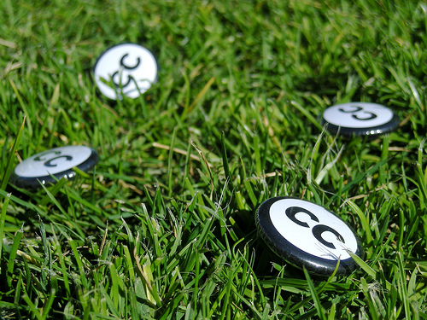



Creative Commons for educators
Jessica Coates
Creative Commons Clinic
April 2008
Carpeted commons by Glutnix, http://www.flickr.com/photos/glutnix/2079709803/in/pool-ccswagcontest07 available under a Creative Commons Attribution 2.0 licence, http://creativecommons.org/licenses/by/2.0/deed.en
AUSTRALIA
part of the Creative Commons international initiative
CRICOS No. 00213J

Slide 2
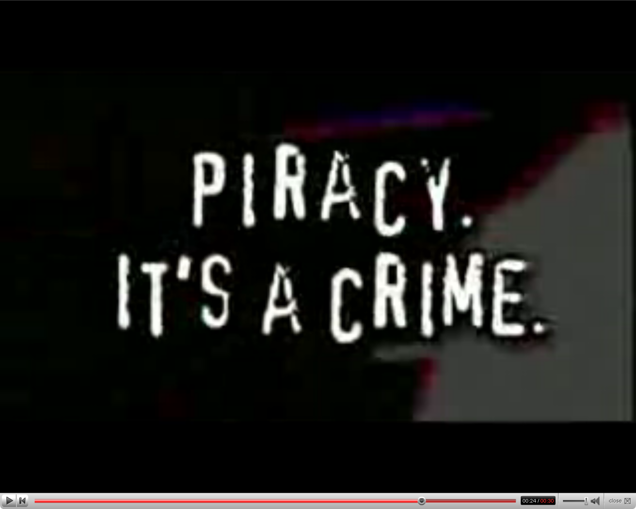

AUSTRALIA
part of the Creative Commons international initiative
CRICOS No. 00213J
Notes:
Standard copyright law says that you can’t reproduce or communicate creative material (eg movies, books, music etc) without the copyright owner’s permission, except in very limited circumstances
The problem with this in the digital era is that every use of material makes a reproduction. This includes just viewing
This means that, under the default copyright laws, printing out a webpage, emailing a picture to your friend, making a digital collage or remix work etc will all generally infringe copyright

Slide 3
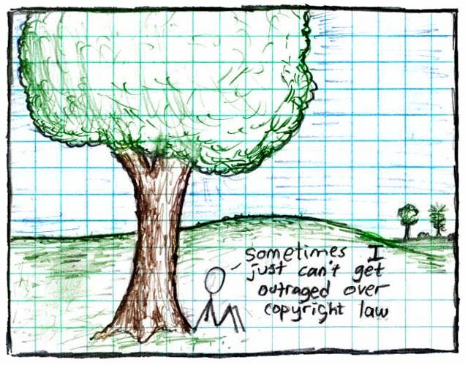
AUSTRALIA
part of the Creative Commons international initiative
CRICOS No. 00213J
Notes:
Standard copyright law says that you can’t reproduce or communicate creative material (eg movies, books, music etc) without the copyright owner’s permission, except in very limited circumstances
The problem with this in the digital era is that every use of material makes a reproduction. This includes just viewing
This means that, under the default copyright laws, printing out a webpage, emailing a picture to your friend, making a digital collage or remix work etc will all generally infringe copyright

Slide 4
Copyright for Educators
Copyright covers everything
Educator exceptions:
  Classroom use
  Fair dealing for research and study
  Education statutory licences – Copyright Act Parts VA and VB
  New s200AB open ended exception
AUSTRALIA
part of the Creative Commons international initiative
Notes:
These licences could be used by copyright owners to give permission in advance for certain uses of their creative material, that would normally be restricted under the standard copyright rules, without having to give up their copyright entirely
The CC founders hoped that making this easier for copyright owners to do would lead to the creation of a digital commons, a pool of creative material was free to be used, distributed and remixed by others, but only under certain conditions

Slide 5

Aims to make creative material more useable by providing free licences that creators can use to give certain permissions in advance
AUSTRALIA
part of the Creative Commons international initiative
CRICOS No. 00213J
Notes:
Non-profit
Founded in 2001
These academics became concerned that the default copyright laws that applied in most countries were restricting creativity in the digital environment by preventing people from being able to access, remix and distribute copyright material online
Taking inspiration from the open source movement, they decided to develop a set of licences that creators could use to make their material more freely available without giving up their copyright
They wanted to replace the standard “all rights reserved” model with a new, more flexible, “some rights reserved”

Slide 6

CC is designed to…
provide standardised licences
that facilitate sharing
are flexible
are easy to use and understand (for people and machines) and
that apply in the same way anywhere in the world.
AUSTRALIA
part of the Creative Commons international initiative
CRICOS No. 00213J
Notes:
In writing the licences, the main goal was to ensure that the licences are:
Voluntary – contrary to some claims, CC isn’t anti-copyright. It just aims to provide options for those copyright owners who do want to make their material more freely available
Flexible – unlike other parts of the open access movement, CC licences are specifically designed to provide a range of options for licensors, so that they can choose exactly how they want their material to be used
Easy to understand – the academics designing the licences felt that one of the biggest problems with default copyright law is that its so hard for both copyright owners and users to understand. So the licences are specifically designed to be as simple as possible.
And, of course, freely available for everyone to use

Slide 7
CC Myths
CC is not:
Anti-copyright – just another rights management tool for creators
The public domain - just giving certain permission in advance
Anti-commercial – can charge for first use, commercial uses, “premium” service, or embed advertising
Right for every situation – entirely voluntary, and won’t be best solution for all creators
AUSTRALIA
part of the Creative Commons international initiative
CRICOS No. 00213J
Notes:
Non-profit
Founded in 2001
These academics became concerned that the default copyright laws that applied in most countries were restricting creativity in the digital environment by preventing people from being able to access, remix and distribute copyright material online
For instances – most people know that it’s currently illegal under Australian law to record a television show to watch later – but did you also know that, in the absence of any licence, it’s also arguably illegal to print off a webpage for personal use, or to use a song in the background of a home video, or a student film
Even those people who want to make their material more freely available can’t do so without hiring lawyers
Taking inspiration from the open source movement, they decided to develop a set of licences that creators could use to make their material more freely available without giving up their copyright
They wanted to replace the standard “all rights reserved” model with a new, more flexible, “some rights reserved”

Slide 8

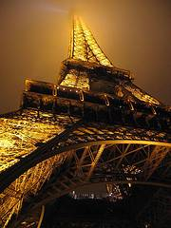
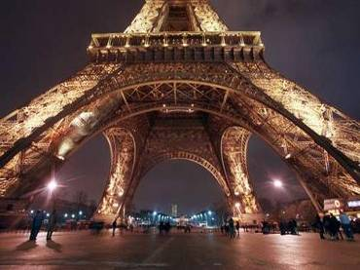
How does it work?
© Sydney Morning Herald
www.smh.com.au
Eiffel Tower at night by rednuht,
http://www.flickr.com/photos/rednuht/275062341/,
Creative Commons Attribution 2.0
http://creativecommons.org/licenses/by/2.0/deed.en
AUSTRALIA
part of the Creative Commons international initiative
CRICOS No. 00213J

Slide 9




Licences
4 licence elements:
        Attribution – attribute the author
        Noncommercial – no commercial use
        No Derivative Works – no remixing
        ShareAlike – remix only if you let others remix
AUSTRALIA
part of the Creative Commons international initiative
CRICOS No. 00213J
Notes:
The first CC licences were released in 2002
The central to each of the CC licences are the four licence elements – Attribution, noncommercial, no derivative and sharealike
These represent restrictions that copyright owners may want to put on how people can use their material.
As you can see, each of the elements has a symbol that can be used to ‘represent’ each of these elements
this makes the licences easier understand – in theory, once a person is familiar with the CC licences, they should be able to recognise what uses are allowed simply by looking at the symbols

Slide 10
Attribution
Attribution-ShareAlike
Attribution-Noncommercial
Attribution-Noncommercial-ShareAlike
Attribution-NoDerivatives
Attribution-Noncommercial-NoDerivatives
AUSTRALIA
part of the Creative Commons international initiative
CRICOS No. 00213J
Notes:
Users can mix and match these elements to set the conditions of use for their material
So, for example, an author may be happy to allow private uses of their work, but may want to limit how it can be used commercially.
They may also want people to remix their work, but only so long as that person attributes them and makes the new work available for others to remix
So they can choose the Attribution-noncommercial-sharealike licence

Slide 11
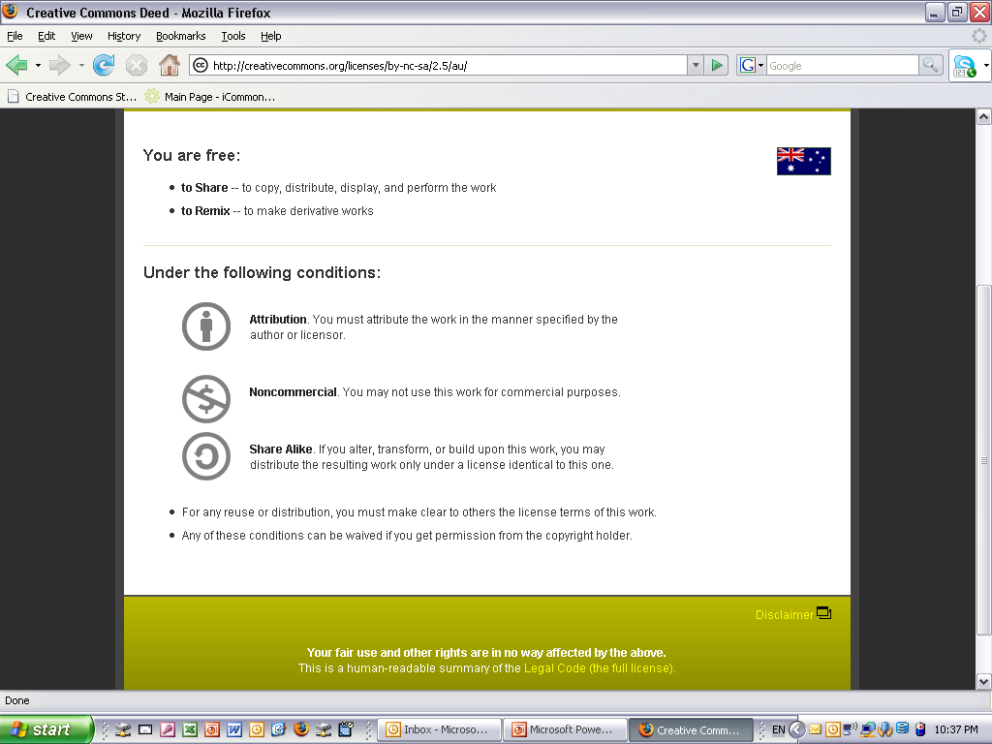
Licences
AUSTRALIA
part of the Creative Commons international initiative
Notes:
. . .to the licence deed, which sets out the licence in plain english terms
You can see the licence element symbols here
By clicking on this link here, you can access . . .

Slide 12
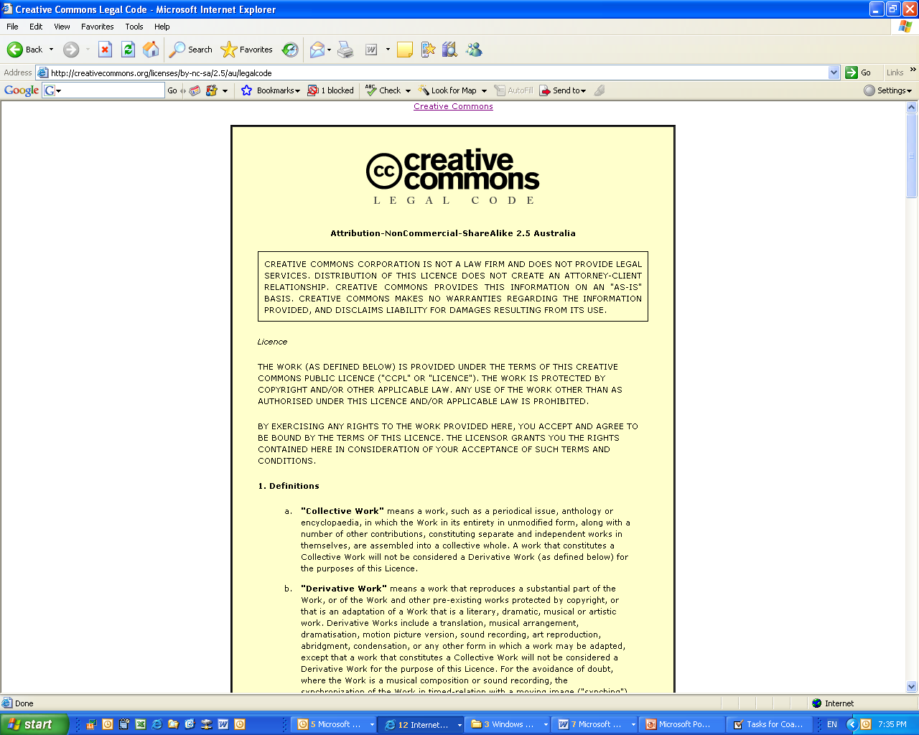
Licences
AUSTRALIA
part of the Creative Commons international initiative
Notes:
The full licence code – which sets out the licence in full legal terms

Slide 13
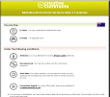
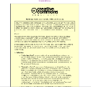
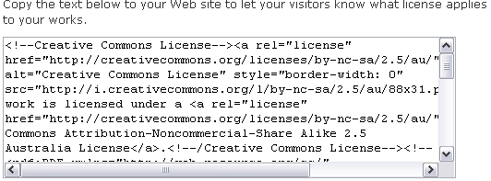
Each licence has
button
deed
metadata
legal code
AUSTRALIA
part of the Creative Commons international initiative
CRICOS No. 00213J
Notes:
CC also has a number of tailored licences, for example:
the Sampling Licences – allow portions of a work, but not the whole, to be remixed into new works, even commercially;
the Public Domain Dedication – lets creators revoke their copyright rights entirely, and donate their work to the public domain;

Slide 14
CC for Education
Provides a source of material that can be legally used beyond the limits of Part VB and s200AB
Can be used to share material with other students / teachers / the world
Can potentially be used to reduce licence fees under Part VB
AUSTRALIA
part of the Creative Commons international initiative
CRICOS No. 00213J
Notes:
The first CC licences were released in 2002
The central to each of the CC licences are the four licence elements – Attribution, noncommercial, no derivative and sharealike
These represent restrictions that copyright owners may want to put on how people can use their material.
As you can see, each of the elements has a symbol that can be used to ‘represent’ each of these elements
this makes the licences easier understand – in theory, once a person is familiar with the CC licences, they should be able to recognise what uses are allowed simply by looking at the symbols

Slide 15
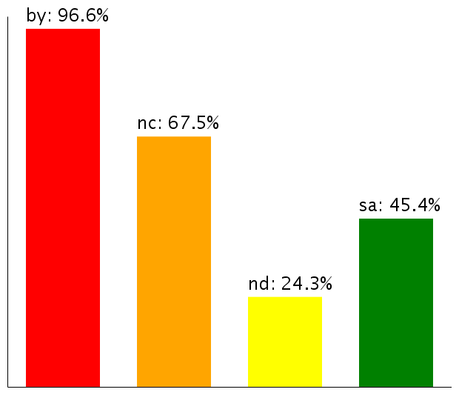
CC as a Resource
About 160 million objects
Over 75 million on Flickr alone
Most have Noncommercial limitation
Moving towards more liberal licences
Use of licence elements – June 2006
AUSTRALIA
part of the Creative Commons international initiative
CRICOS No. 00213J
Notes:
So – looking at how the CC licences are being used
According to the latest statistics from the CC website, there are currently about 140million webpages that use a CC licence
As you can see, almost all of them contain the BY element – that’s because it was made compulsory for all the licences except the public domain licences after the first year, because pretty much everybody was using it anyway
The majority also, unsurprisingly, choose the non-commercial element
Interestingly, next most popular is ShareAlike, not noderivatives – this shows that there is still a strong focus on fostering creativity among CC community, and that, rather than trying to lock their material up, people are happy for it to be remixed, as long as the new work is also sharedEven more interesting is how these statistics are changing over time
Even more interestingly – if you look at how the licences is being used over time, people are gradually moving towards more liberal licences with less restrictions on them
This movement seems to indicate that as people become more familiar with the licences, they are more comfortable allowing greater use
This is supported by anecdotal evidence from CC users who, after initially publishing their material under restrictive licences that don’t allow derivatives, often ‘re-release’ their material to allow new works

Slide 16










Finding CC material
AUSTRALIA
part of the Creative Commons international initiative
CRICOS No. 00213J

Slide 17
Things to think about
Before using CC material:
Check that you’re following the licence (ask for extra permission if necessary)
Do you need any other rights?
Make sure your use isn’t ‘derogatory’
Use common sense
Don’t forget to attribute
AUSTRALIA
part of the Creative Commons international initiative
CRICOS No. 00213J

Slide 18

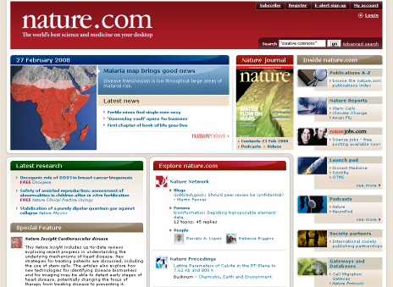
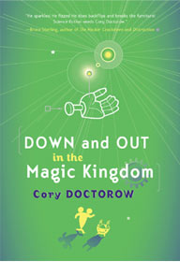

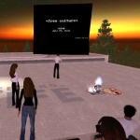
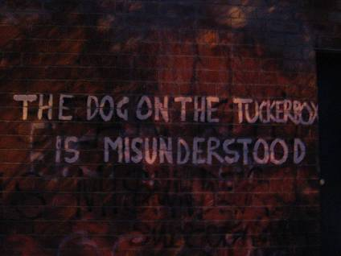

CC as Tool
By Ford Motor company
http://www.flickr.com/photos/fordmotorcompany/2267225172/
Facilitate collaboration
Increase reach and reputation
Don’t reinvent the wheel
Community building
Access new business models
Give new value to ‘back catalogue’
Reduce costs for users
Legal clarity and reduced admin
Increase sum of human knowledge
Encourage innovation
AUSTRALIA
part of the Creative Commons international initiative
CRICOS No. 00213J
Notes:
In writing the licences, the main goal was to ensure that the licences are:
Voluntary – contrary to some claims, CC isn’t anti-copyright. It just aims to provide options for those copyright owners who do want to make their material more freely available
Flexible – unlike other parts of the open access movement, CC licences are specifically designed to provide a range of options for licensors, so that they can choose exactly how they want their material to be used
Easy to understand – the academics designing the licences felt that one of the biggest problems with default copyright law is that its so hard for both copyright owners and users to understand. So the licences are specifically designed to be as simple as possible.
And, of course, freely available for everyone to use

Slide 19
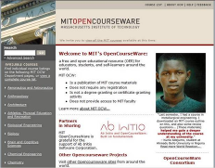


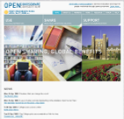

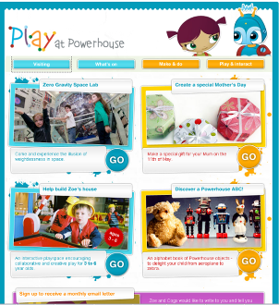
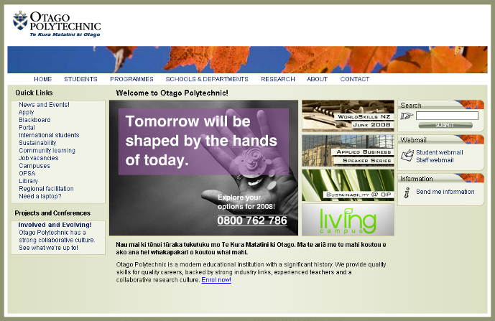



Open Education Resources
AUSTRALIA
part of the Creative Commons international initiative
CRICOS No. 00213J
Notes:
As well as the CC website, you can also download the generator to your desktop, as part of the ccPublisher
This helps you automatically label your material as CC, and publish it online
In an interesting development, Microsoft has also recently released an plugin that allows you to label any work created in an Office as CC.
A number of sites also let you licence your material as cc – including flickr, and blip.tv

Slide 20
Things to think about
Before using CC licences:
Who do you want to use the material, and when? eg global, perpetual
Are you choosing the right licence? eg do you want them to be able to change your material?
Do you have the rights to license the material? Are you using anyone else’s material?
Policy?
AUSTRALIA
part of the Creative Commons international initiative
CRICOS No. 00213J

Slide 21
Thanks
www.smartcopying.edu.au
creativecommons.org
wiki.creativecommons.org/casestudies
creativecommons.org.au
info@creativecommons.org.au
Carpeted commons by Glutnix, http://www.flickr.com/photos/glutnix/2079709803/in/pool-ccswagcontest07 available under a Creative Commons Attribution 2.0 licence, http://creativecommons.org/licenses/by/2.0/deed.en
This slide show is licensed under a Creative Commons Australia Attribution licence. For more information see http://creativecommons.org/licenses/by/2.5/au/.
AUSTRALIA
part of the Creative Commons international initiative
CRICOS No. 00213J

